Slide 1

Burglar Detection System
TEAM MEMBERS MOODLE ID
TEJAS SHETH 19102026
POOJAN SHAH 20202001
RAKSHIT SHAH 19102008

Slide 2
Contents
Introduction
Proposed System
Objectives & Scope
Experimental Setup
System Implementation
Result
Conclusion

Slide 3
Introduction
The need to have good security, either in the streets, at home or at workplaces, cannot be overemphasized.
The computing and information technology revolution has significantly affected how people deal with security.
Machine vision application has been developed for security purposes, especially, by improving surveillance systems.
This report seeks to analyze how Machine Vision systems can be of help in surveillance processes including tracking burglars, strange behaviour, and crime in general.

Slide 4
Proposed System
To detect motion in and around the security camera’s point of view.
To sound an alarm to alert the surrounding for any extreme movements.

Slide 5
Objective & Scope
Can be implemented in a security domain as security camera
Can be used as a motion detection system, to detect any motion within the camera vicinity.
To play an alert sound when motion is detected.

Slide 6
Experimental Setup
Hardware Requirements
2.8GHz 64 bit processor CPU, minimum 4GB RAM,
4GB free Storage, Camera, Speaker
Software Requirements
Python, Python libraries, VS Code, Git & GitHub,
Google Workspace

Slide 7
System Implementation
To initiate video capture:
camera = cv2.VideoCapture(0)
To detect motion using the difference of 2 consecutive frames:
frameDifference = cv2.absdiff(frame1, frame2)
Gray Scaling:
grayImg=cv2.cvtColor(frameDifference, cv2.COLOR_BGR2GRAY)
Blurring:
blurImg = cv2.GaussianBlur(grayImg, (5,5), 0)
Thresholding:
_,thresh =cv2.threshold(blurImg,20,255,cv2.THRESH_BINARY)
Dilation:
dilated = cv2.dilate(thresh,None,iterations=3)
Contour Detection:
contours,_ = cv2.findContours(dilated,cv2.RETR_TREE, cv2.CHAIN_APPROX_SIMPLE)
Bounding Rectangle:
xAxis,yAxis,width,height = cv2.boundingRect(contourSize)
cv2.rectangle(frame1,(xAxis,yAxis),(xAxis+width,yAxis+height),(0,0,255),2)

Slide 8
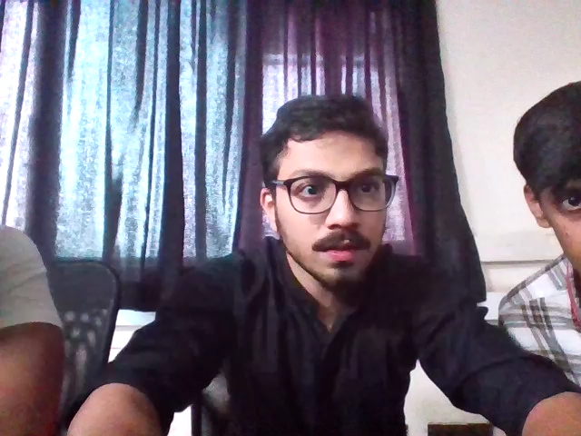
Result

Slide 9
Thank You...!!

